Slide 1
www.penta-force.com
info@penta-force.com
Madan Singh +91 98190 64216

Slide 2
Real-time Production Awareness
The CountWONDER Wireless Production Monitoring System is an IoT device that automatically captures precise and up-to-the-minute production data directly from machines
Output Counts
Machine Status
Breakdowns and Waiting Periods
Speed of Production
Machine Stoppages
And much more...
Print owners can now know exactly what is happening at their presses LIVE even when they are not
around…

Slide 3
Smartest Companion to PrintWONDER
CountWONDER is the next step in the development of Pentaforce’s product portfolio, expanding the convergence ratio of existing services with an emphasis on performance, sustainability and the creation of new revenue streams.
This next generation IoT technology builds intelligence on your shop floor, helping you use production data to make strategic business decisions that optimize workflow and production capabilities.
Can be installed on your printing machines (sheet fed/web offset, flexo), die cutting, lamination or any other post press operations machines easily

Slide 4
Complete Visibility of Production in your Shop Floor
CountWONDER captures real-time data and helps you serve customers by providing insights into the ongoing production on your shop floor for efficient production management
Plug and GO technology
No integration to your existing machines required
Automatic production data capture in real-time
Reporting consistent production audit trail in the company
Enhance the job communication process from production to customer service

Slide 5
CountWONDER provides Data Driven Reports that provide visibility to…
Know production capabilities to precisely plan schedules
Identify and minimize non-productive downtime
Minimize wastages
Increase production
Optimize requirements for estimation and output
Optimize the production process & capacity utilization

Slide 6
CountWONDER Features
Actual Production Time Monitoring
Time Logging of Job Start and End
Charts displaying machine and operator efficiency
Operator Performance Monitoring
Makeready Time Monitoring

Slide 7
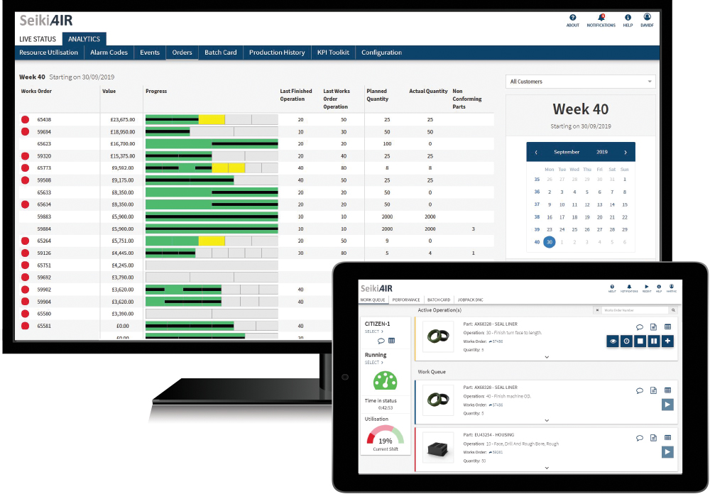
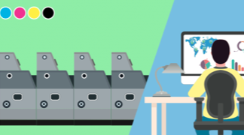
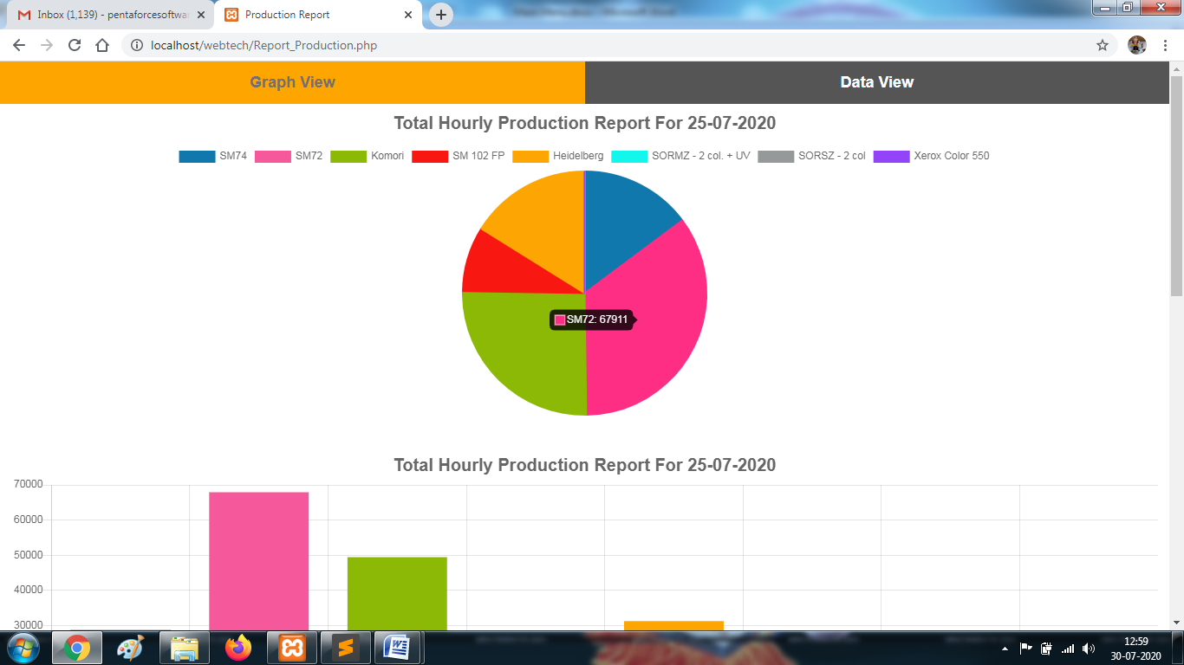
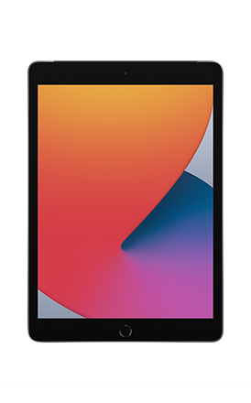
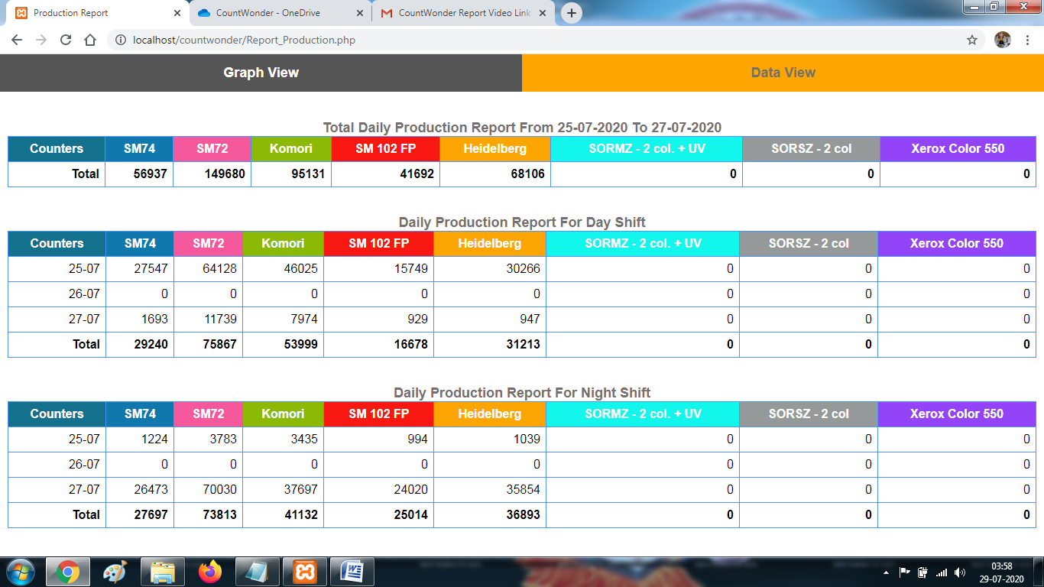
Advantages of CountWONDER
Enhanced accuracy of production data with real-time WiFi connectivity
All events captured and minimized overruns and underruns
Instant availability of job status, extensive reporting and reason codes enabling punctual and economical decisions
Automated data collection eliminating human intervention
Visual charts depicting productive/non-productive downtimes
Operators informed with most recent instructions and guidance – increasing competitiveness and productivity
Improved overall visibility and control of production
Data collected enables profitable decisions to be made
Review data from various remote smart devices
Identify and address any circumstances or issues

Slide 8
Our Valued Customers

Slide 9
Testimonials
“It has changed my working schedule completely giving me a lot of spare time. Not only spare time, it helps me depend on my office staff to revise the estimates at the back end call of my clients.”
“Ever since we approached you, I could see the Best Professional Approach you had towards your customer. Your repetitive visits, as and when required, understanding our needs, providing solutions at min. time, show that your urge to understand and satisfy your customer's needs is excellent."
- Mr Vishwanath Shetty
The PrintWorks, Mumbai
- Mr Amar Yadav Sun Pharmaceutical Ind. Ltd.
“I am really enjoying working estimates through this package. It is simple, fast, accurate & user friendly. Especially provisions such as cloning, printing job cards & final estimate are superb.”
- Director
For Almats Printing Solutions Pvt. Ltd.

